Slide 1





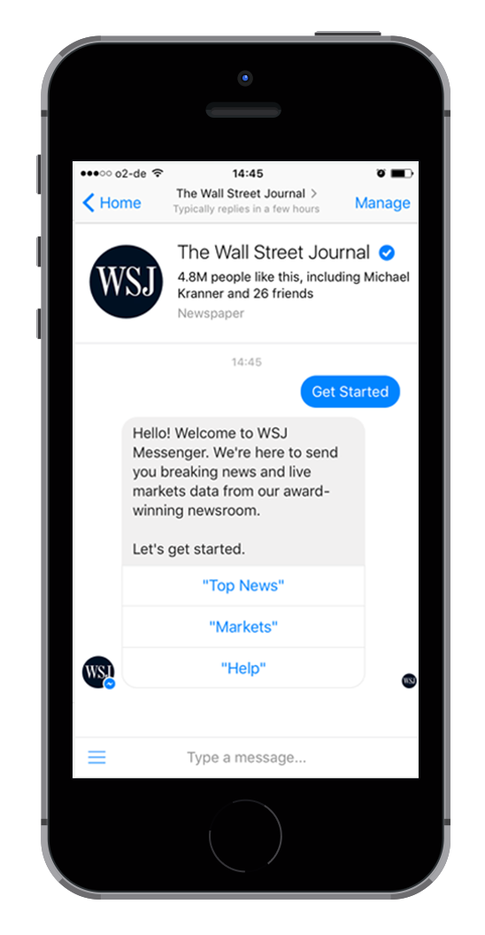







Analyzing WSJ for Facebook Messenger
Chatbot Studies

Slide 2




Chatbot Studies

Slide 3

Chatbot Studies
Hello there!

Slide 4


Chatbot Studies
This is part of an ongoing series to understand what’s behind great conversational design in chatbots.

Slide 5
Chatbot Studies
Find more stuff here: www.chatbot-academy.com

Slide 6



Let’s go!
Chatbot Studies

Slide 7
This welcome message states the main three features of the bot. On point!
Chatbot Studies

Slide 8
Chatbot Studies
Let’s hit that button and get started

Slide 9
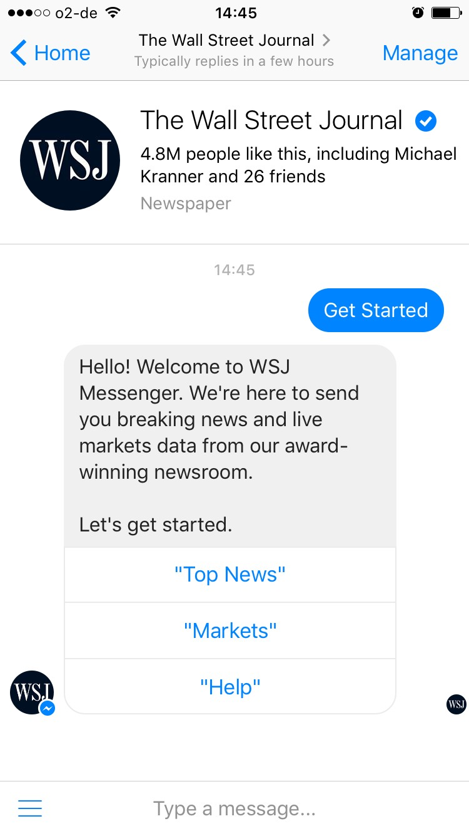
Chatbot Studies

Slide 10
Branding as “we” to circumvent gender discussions and to help users empathize with the team
Chatbot Studies

Slide 11
Problem: It can be difficult to make users understand that this is a bot, not real humans typing
Chatbot Studies

Slide 12
“Award-winning,” that sounds nice!
Chatbot Studies

Slide 13
Makes me want to rub my hands together and take action!
Let’s do this.
Chatbot Studies

Slide 14
Interesting choice to put button labels in quotation marks.
Chatbot Studies

Slide 15
Makes me understand I can also access these features by typing.
Chatbot Studies

Slide 16
(although it looks a bit weird at first)
Chatbot Studies

Slide 17
Chatbot Studies

Slide 18

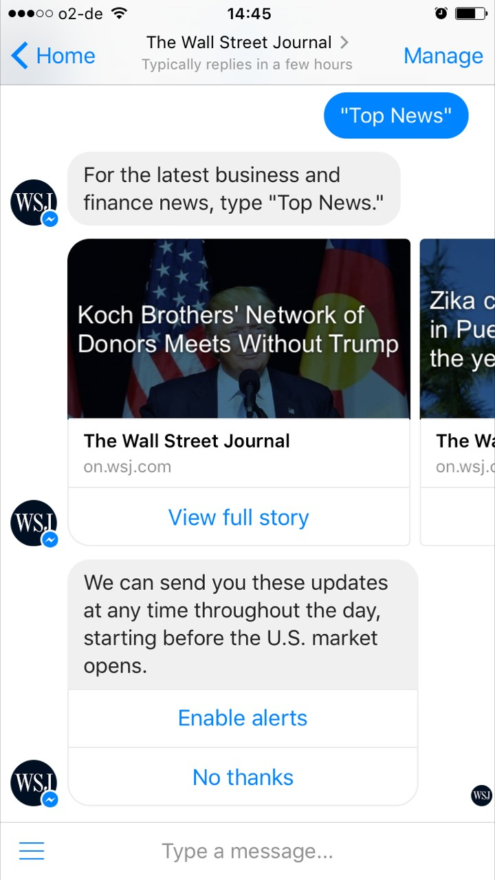
Chatbot Studies

Slide 19


Great choice to help people understand how this feature can be accessed at a later point
Chatbot Studies

Slide 20
Chatbot Studies
Perfect use of thumbnails allows for news snacking

Slide 21

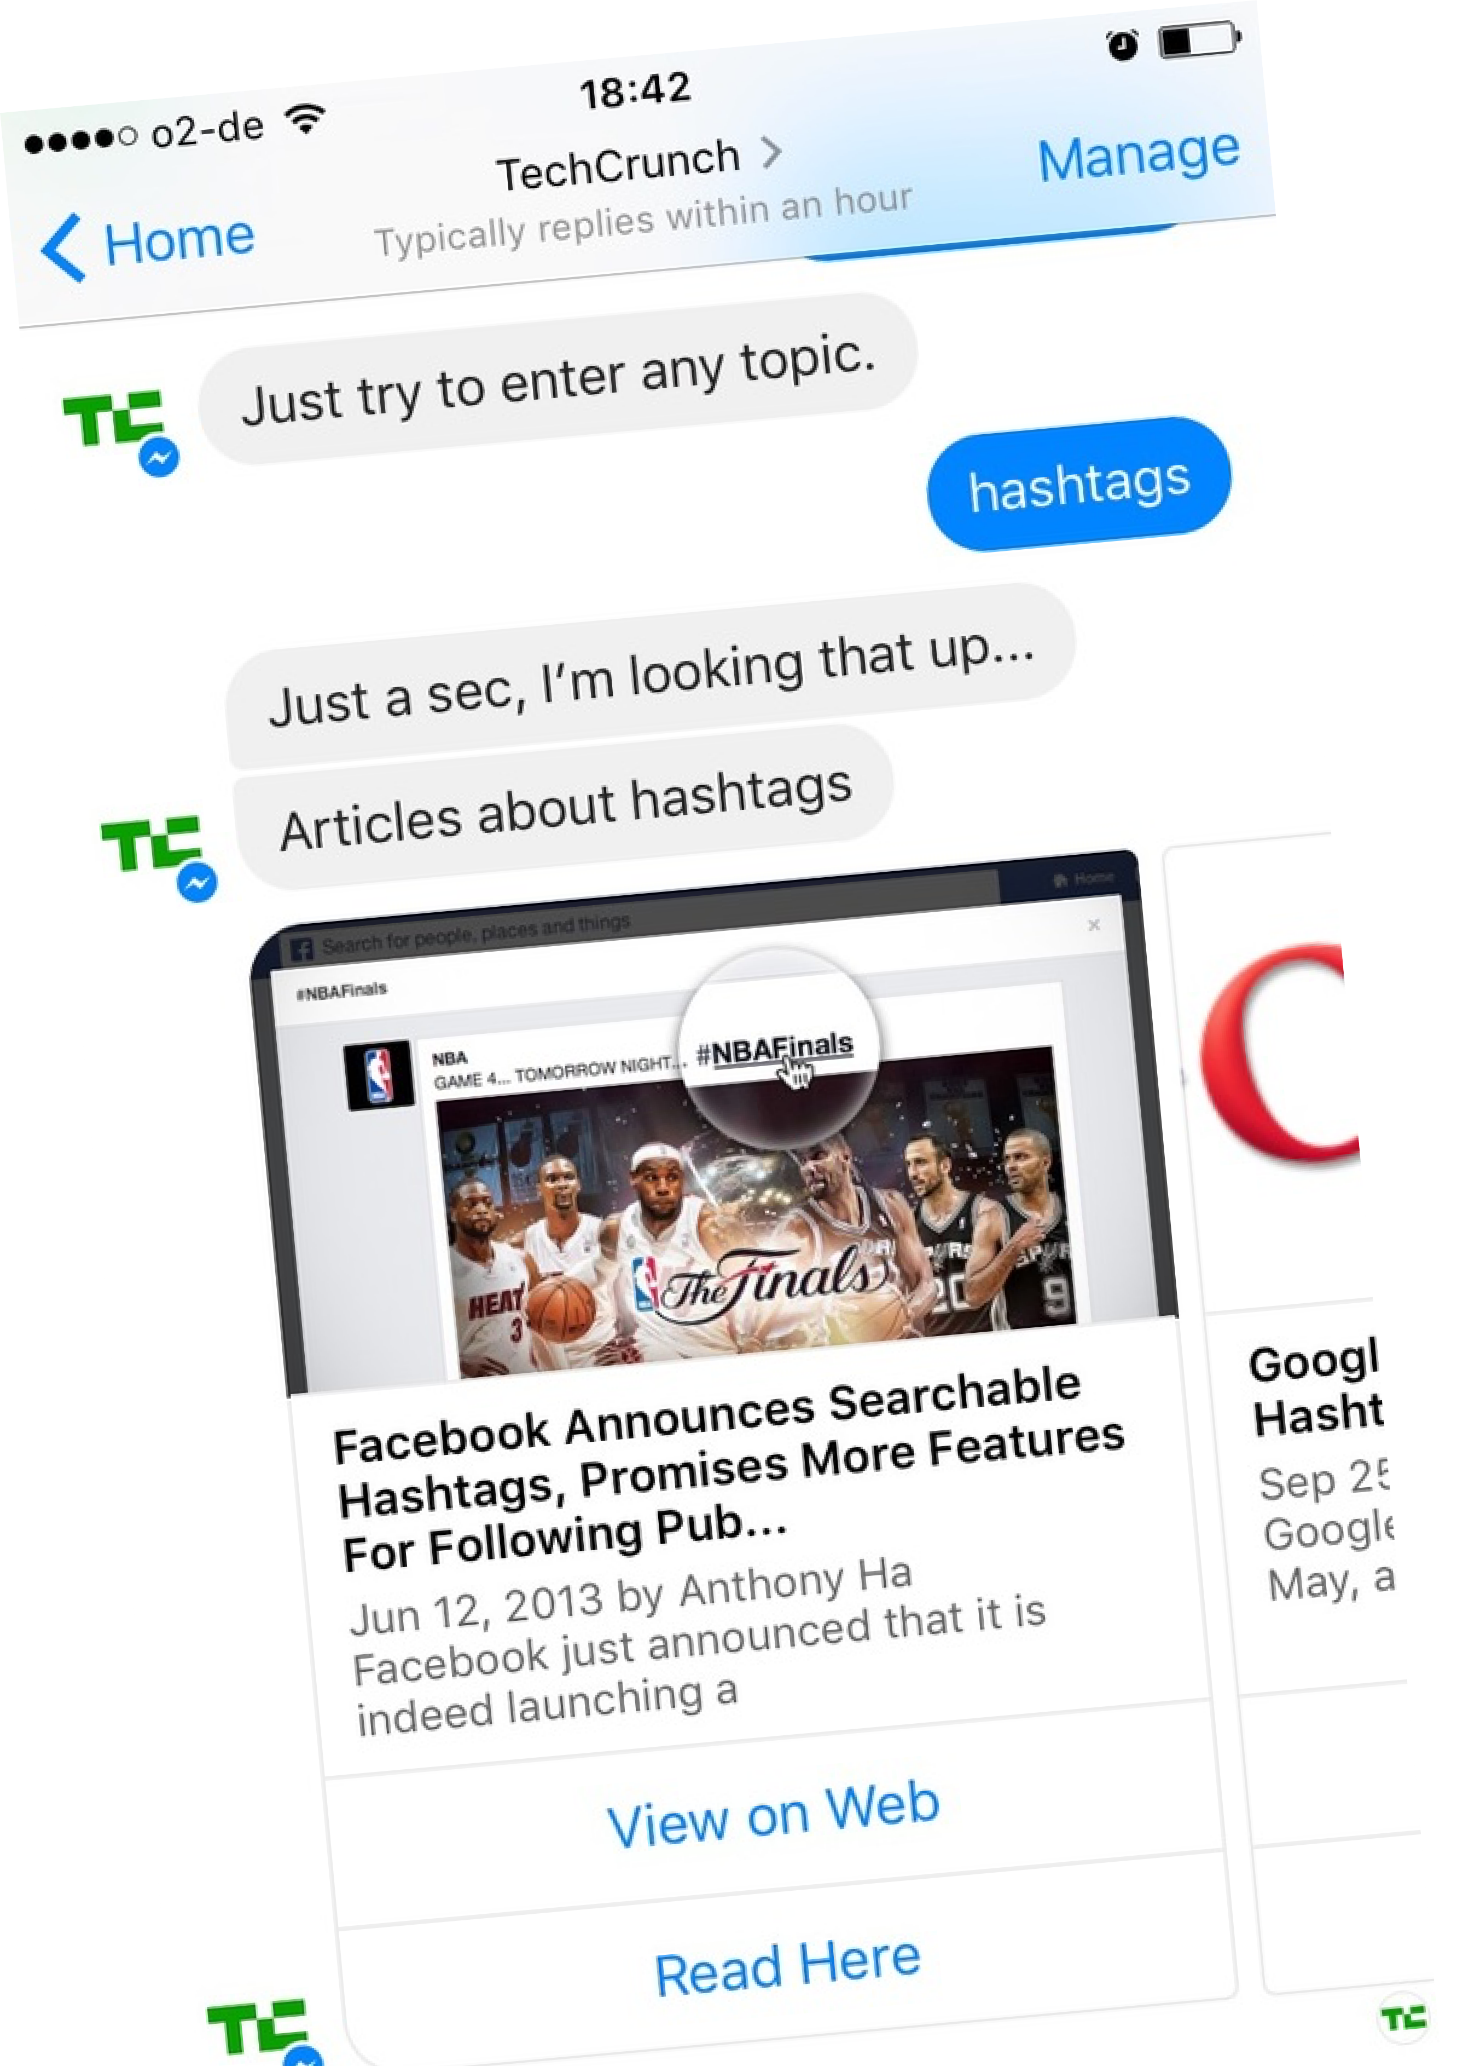
Chatbot Studies
Compated to TechCrunch, you can easily see that it’s better UX to have text on thumbnails

Slide 22
Chatbot Studies

Slide 23
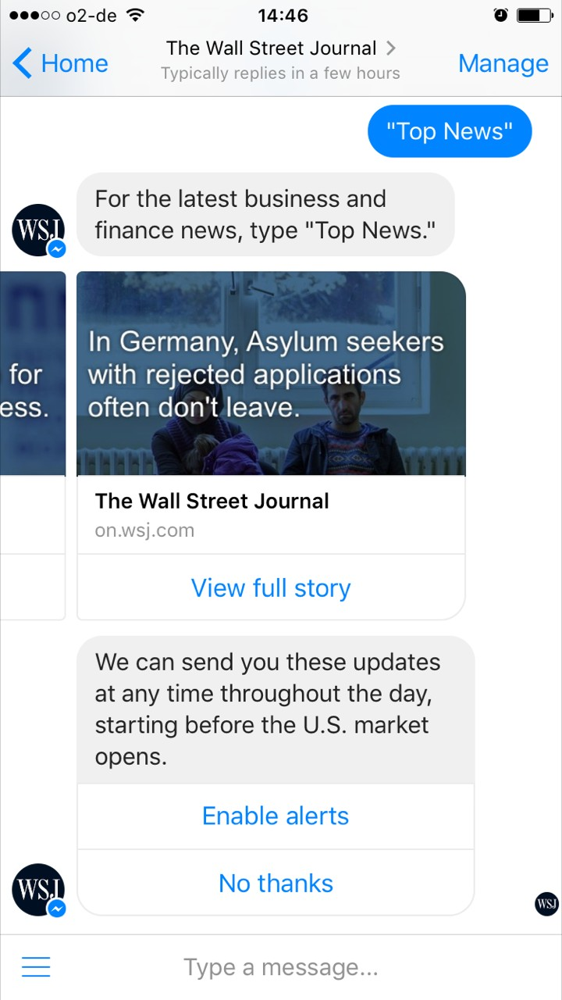
Chatbot Studies

Slide 24
Chatbot Studies
Where do these teasers come from? Let’s have a look at one article

Slide 25
Chatbot Studies
Seems like they’re just pushing links.
Would love to consume the article here

Slide 26

Ah, OK. They use content from their What’s News app
Chatbot Studies

Slide 27

Let’s go back.
Chatbot Studies

Slide 28
Chatbot Studies

Slide 29
Asking for permission to send broadcast messages.
Chatbot Studies

Slide 30
Chatbot Studies
But let’s don’t do that right now

Slide 31
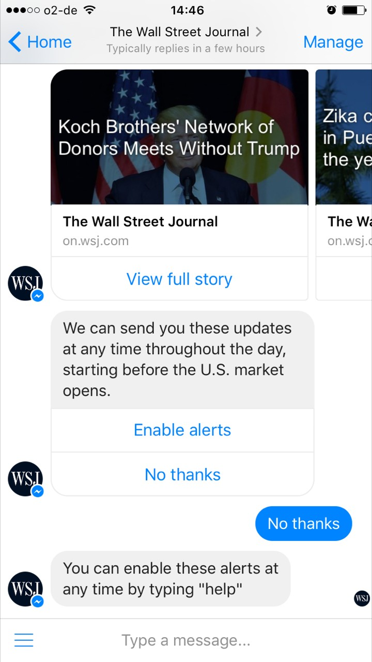
Chatbot Studies

Slide 32
Chatbot Studies
Thanks for letting me know, why “help,” though?

Slide 33

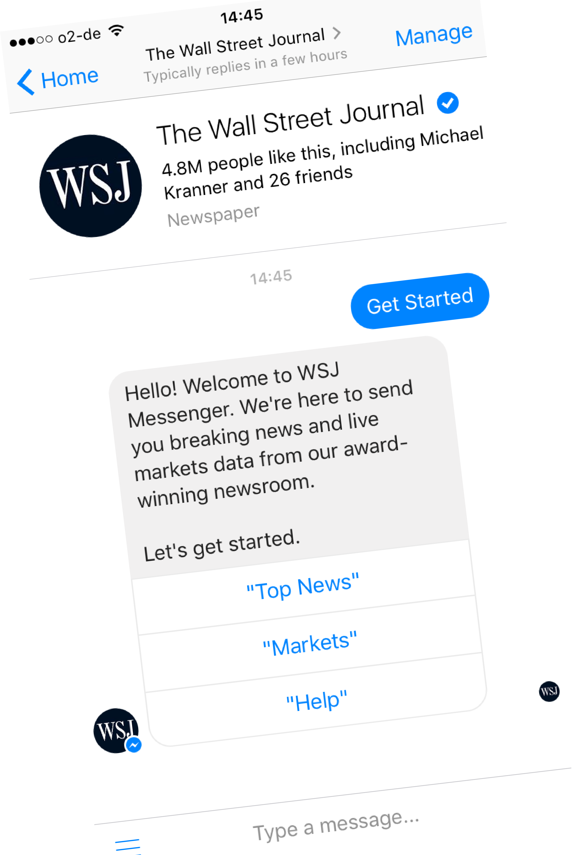
Chatbot Studies
Let’s scroll back up and try “Markets” from before

Slide 34
Chatbot Studies
Let’s scroll back up and try “Markets” from before

Slide 35
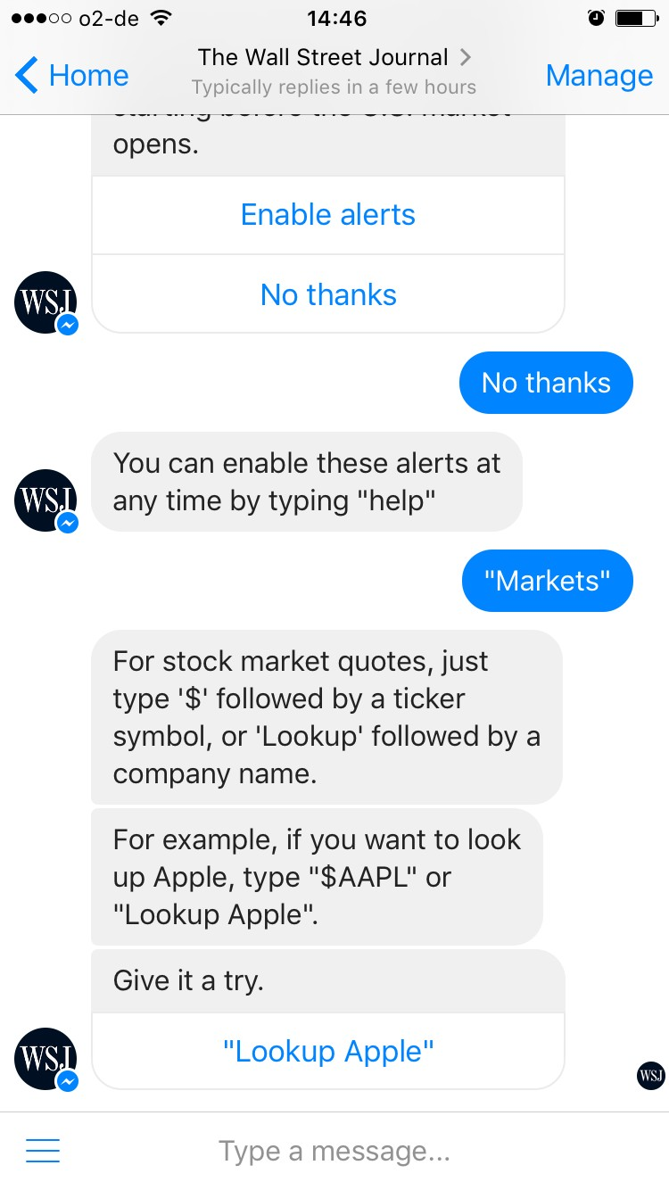
Chatbot Studies

Slide 36
First letting me know how to access this feature at any time
Chatbot Studies

Slide 37
Chatbot Studies
This is perfect: I don’t have to come up with

Slide 38
Chatbot Studies
However, does this really need to be 3 messages long?

Slide 39

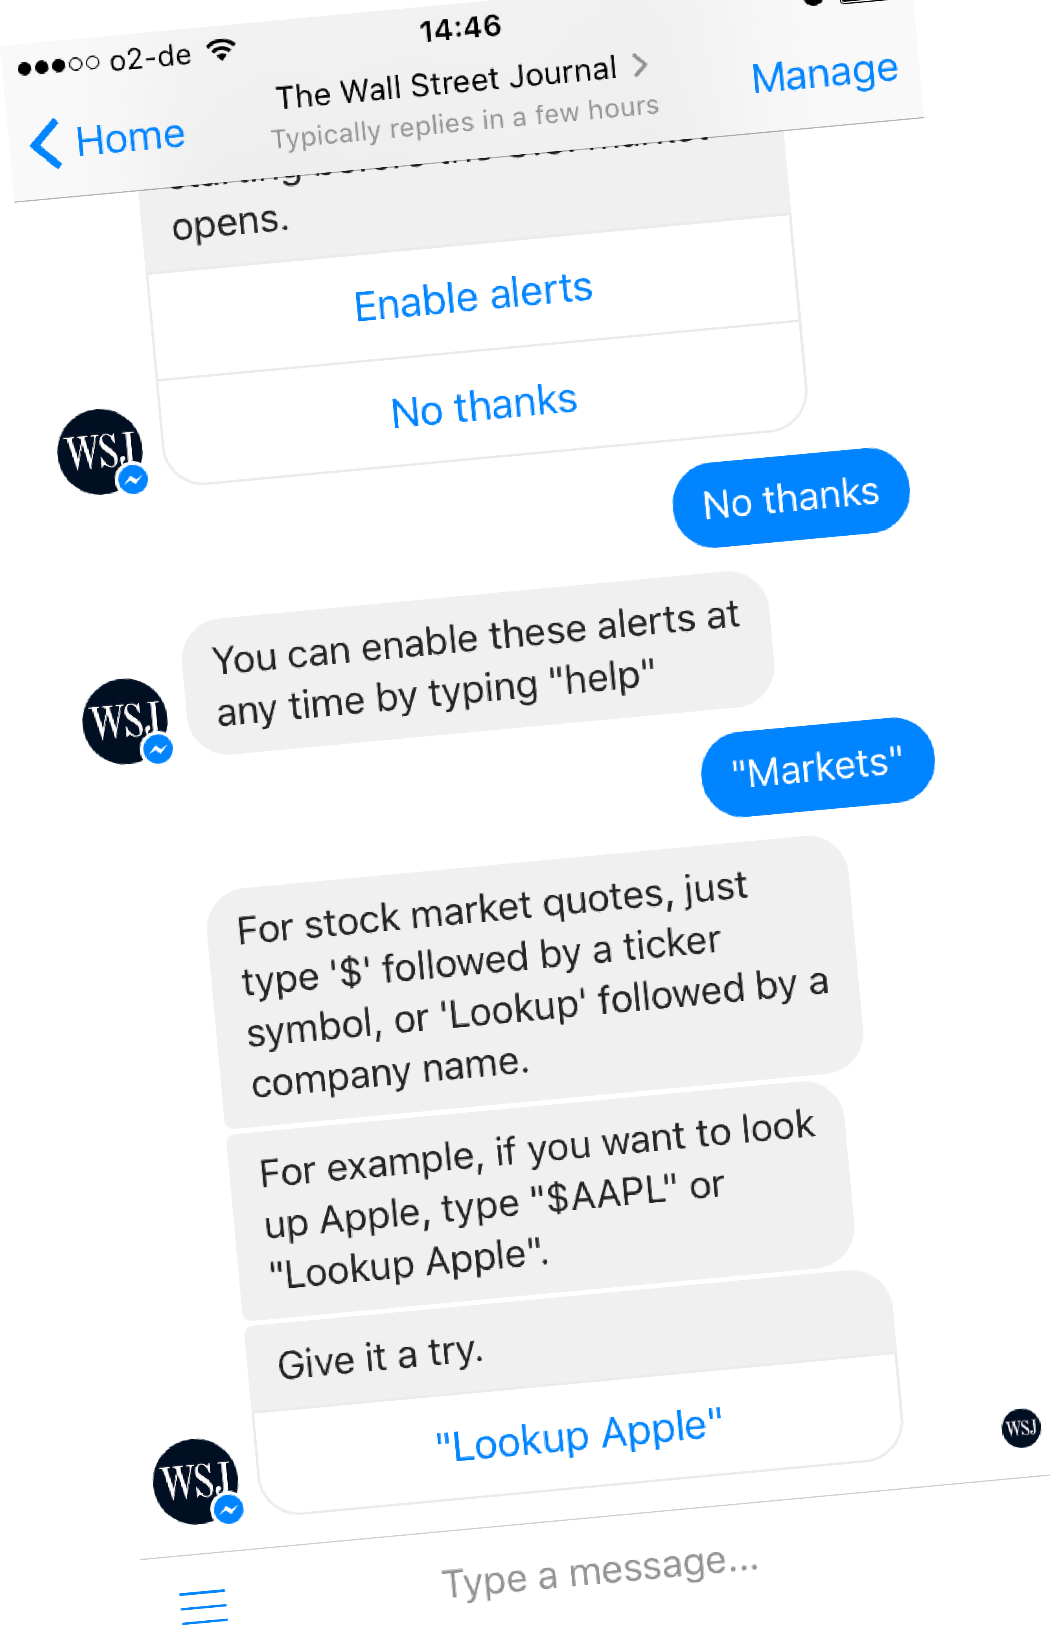
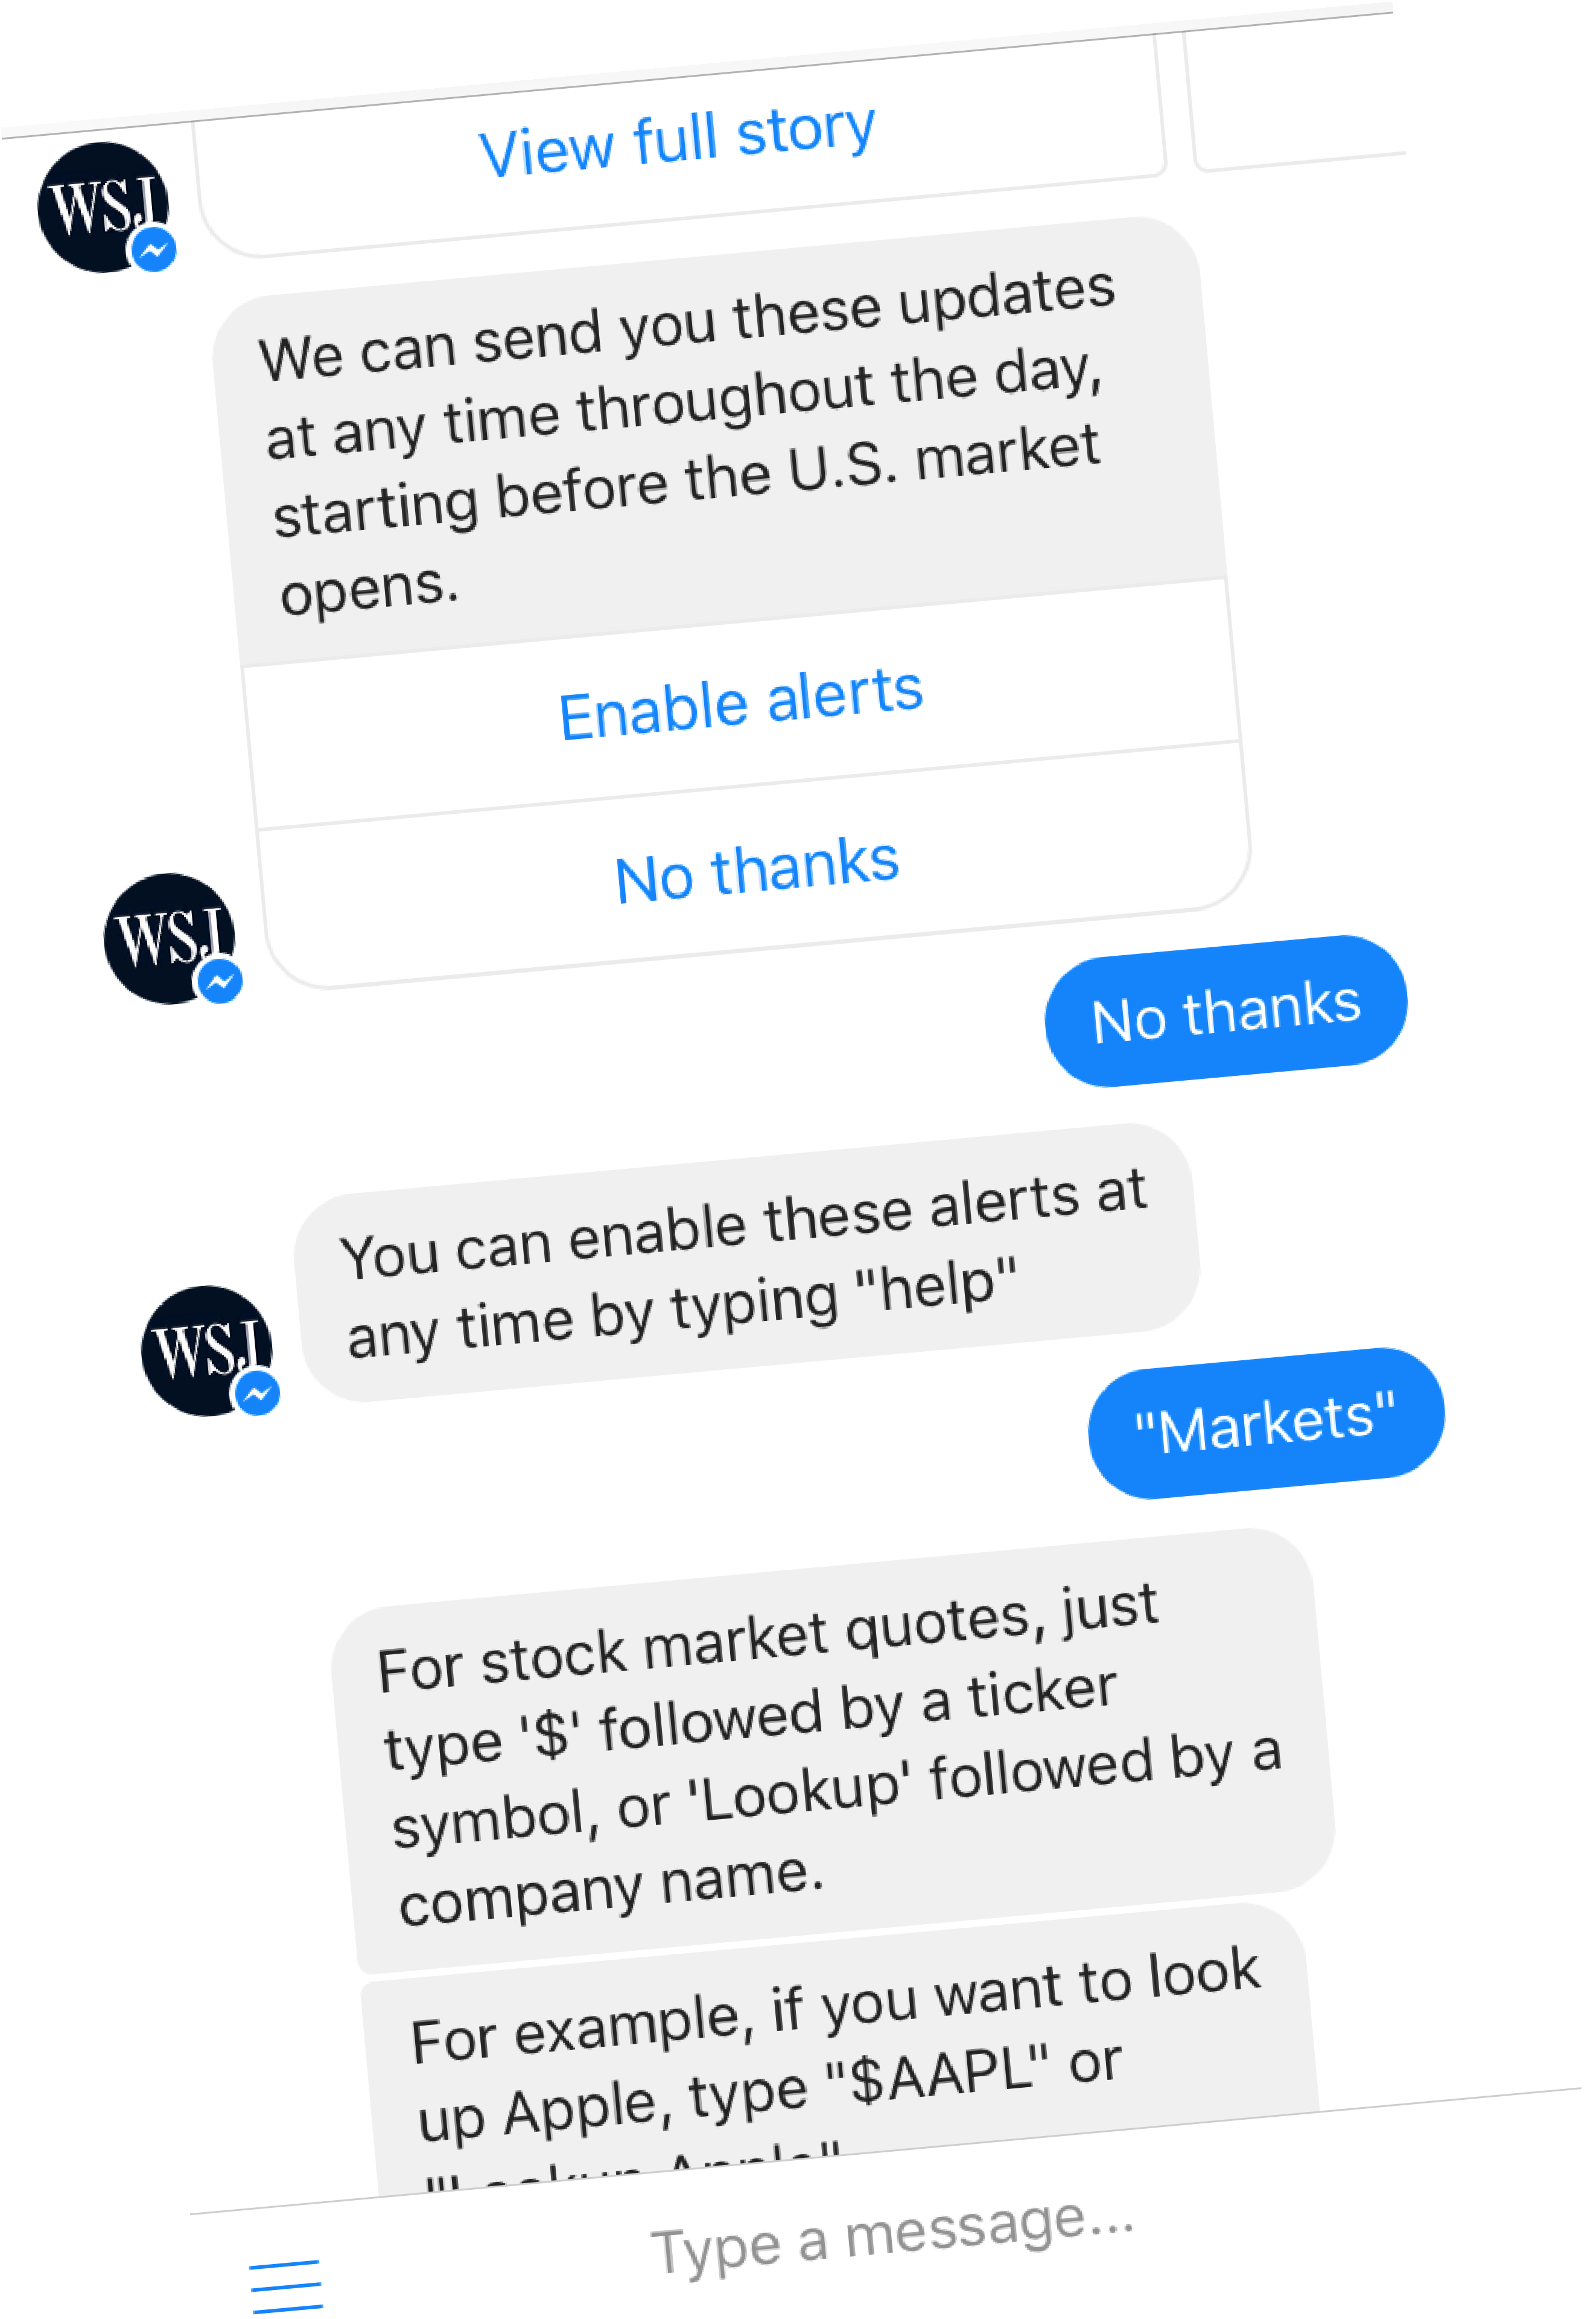

Chatbot Studies
Maybe you could get rid of 2 messages and use quick replies and a list of examples?
“Lookup Apple”
Show examples

Slide 40
Chatbot Studies
Let’s give it a try, though

Slide 41
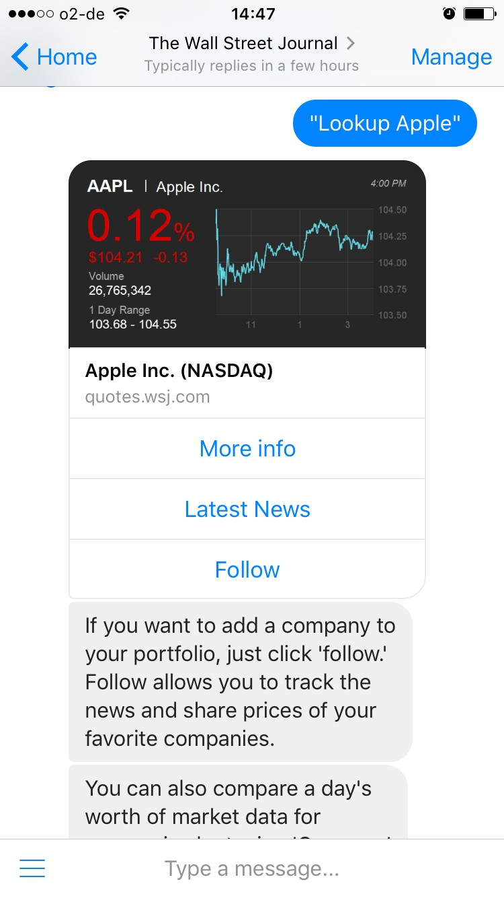
Chatbot Studies

Slide 42

Looking good!
Chatbot Studies

Slide 43
Chatbot Studies
Again, there is a lot of text. Is there any other way to make users understand how it works?

Slide 44
Let’s do it!
Chatbot Studies

Slide 45
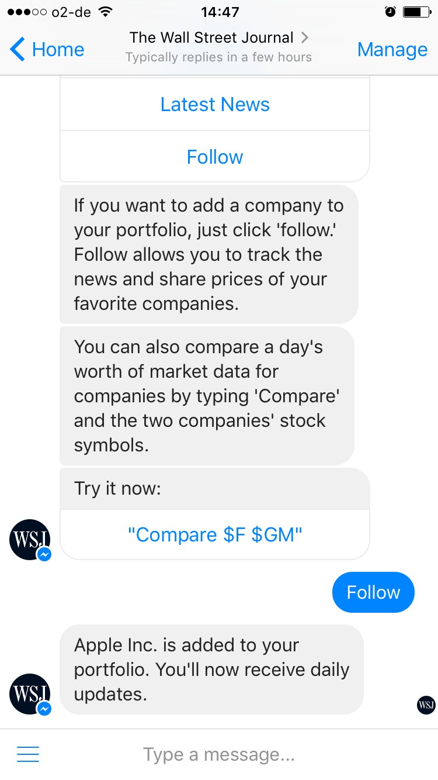
Chatbot Studies

Slide 46
Chatbot Studies
Where are the emotions?

Slide 47
This comparison feature looks interesting. Again, it’s a lot of text.
Chatbot Studies

Slide 48
Chatbot Studies

Slide 49
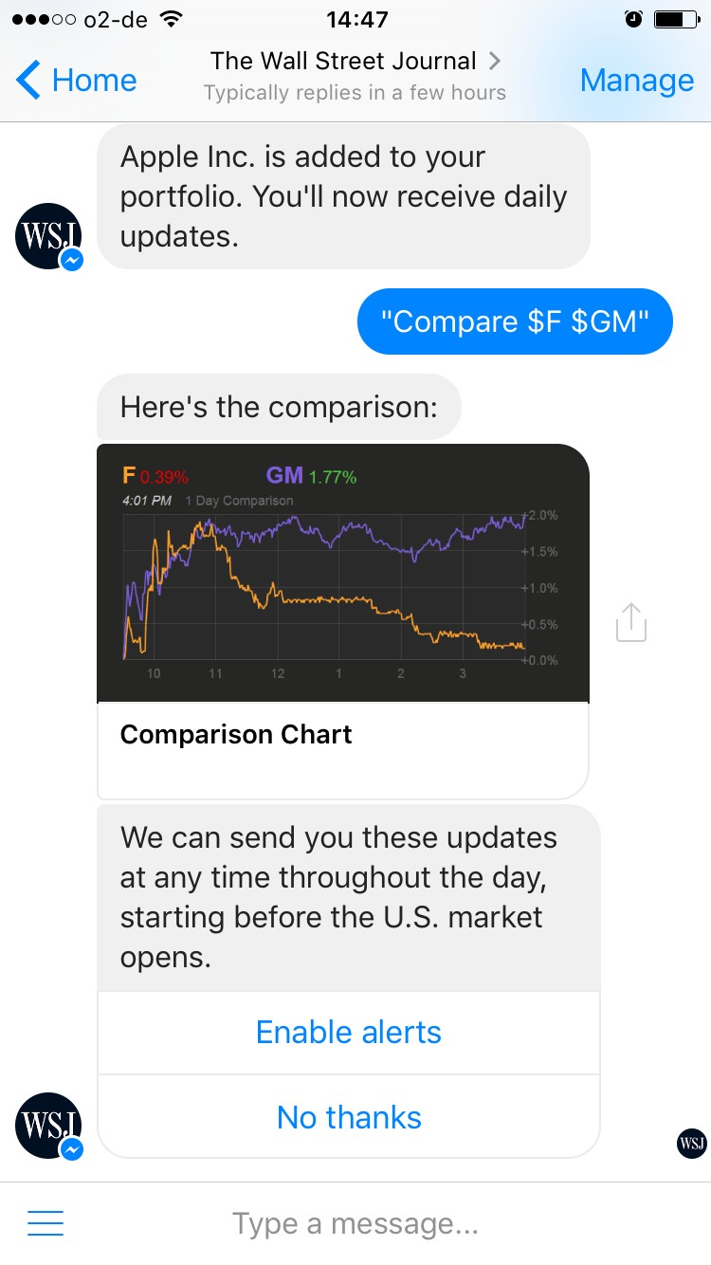
Chatbot Studies

Slide 50
Chatbot Studies
Looking good! (again)

Slide 51
Chatbot Studies
OK, I can follow comparisons? That’s cool

Slide 52
Chatbot Studies
Not now, though.

Slide 53
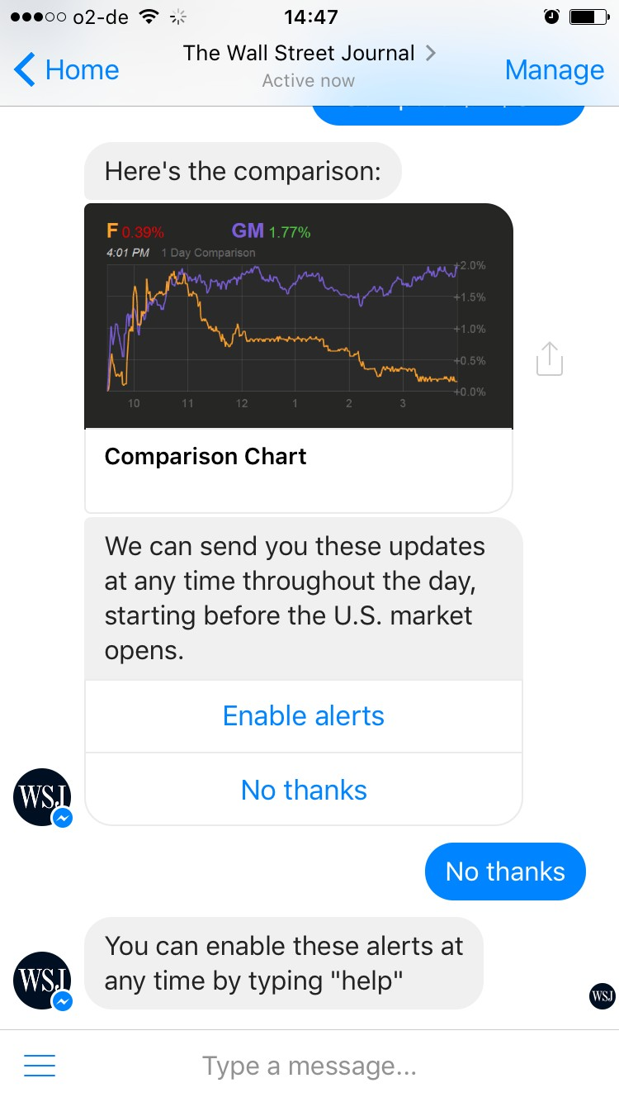
Chatbot Studies

Slide 54
Chatbot Studies
Let’s try the persistent menu

Slide 55
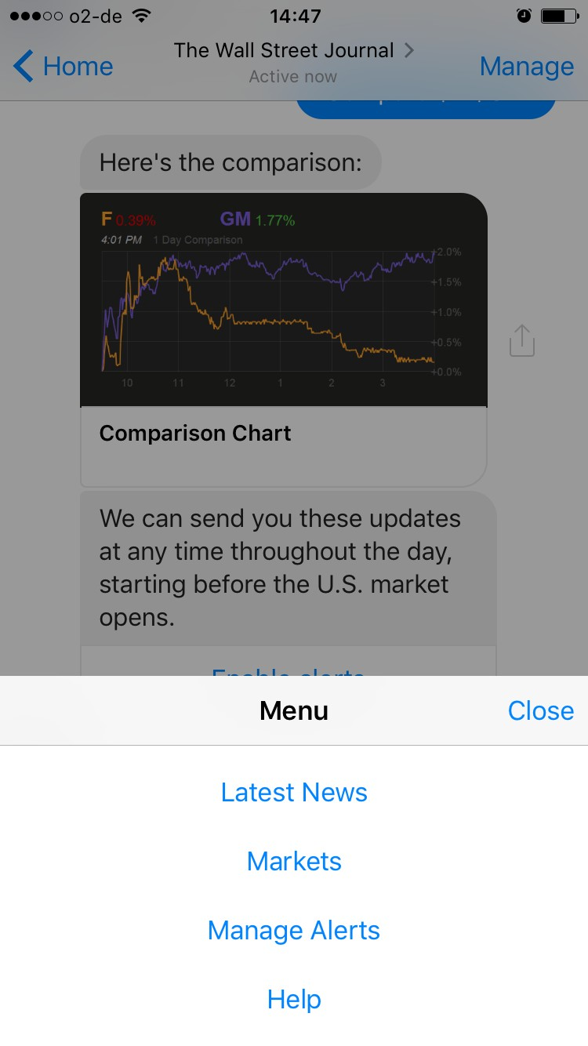
Chatbot Studies

Slide 56
Chatbot Studies

Slide 57
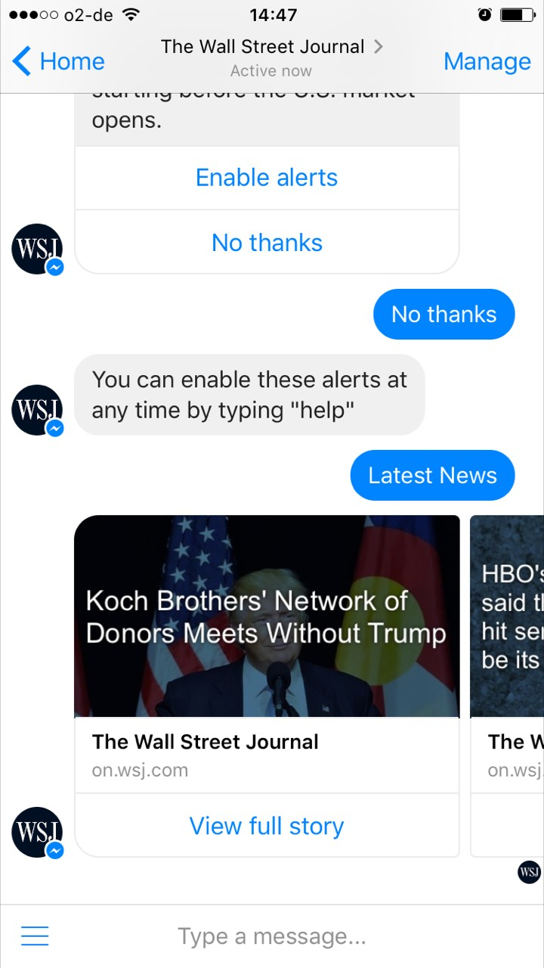
Chatbot Studies

Slide 58
Chatbot Studies

Slide 59
Chatbot Studies

Slide 60
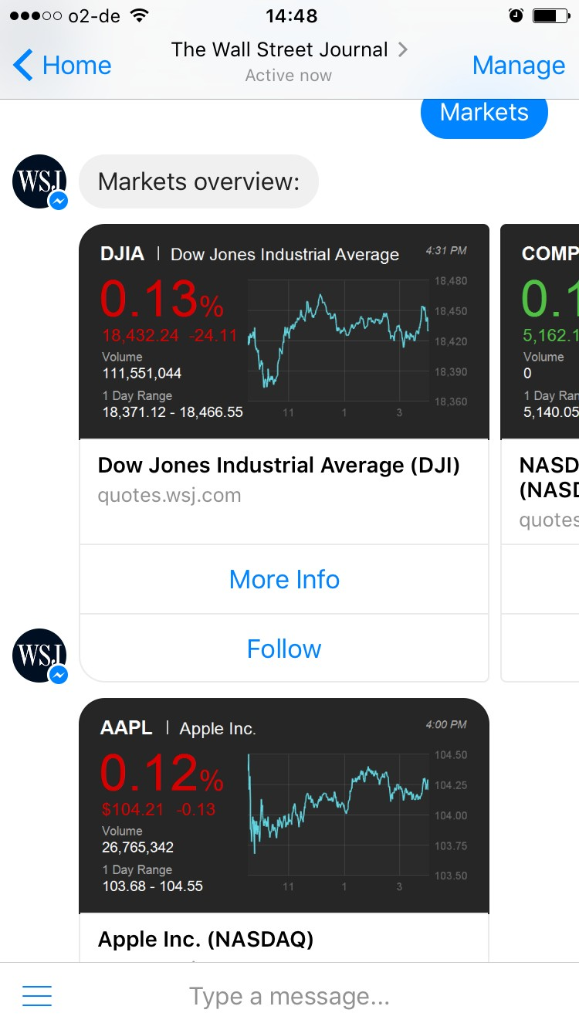
Chatbot Studies

Slide 61
Chatbot Studies
These are the ones I follow

Slide 62
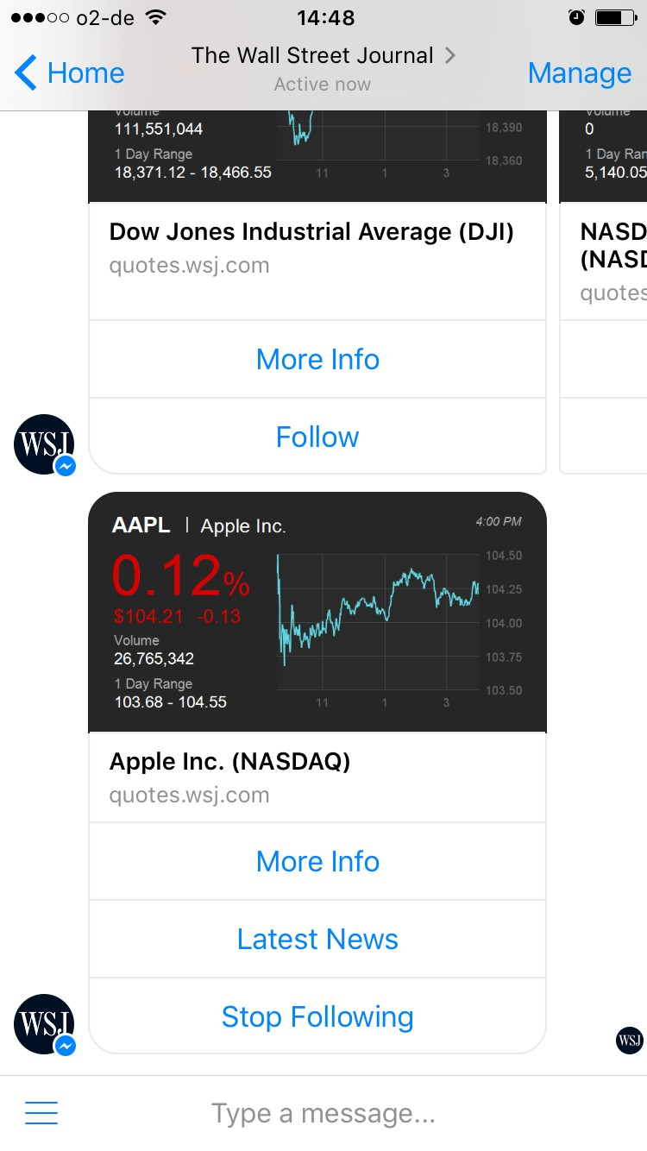
Chatbot Studies

Slide 63
Chatbot Studies

Slide 64
Chatbot Studies

Slide 65
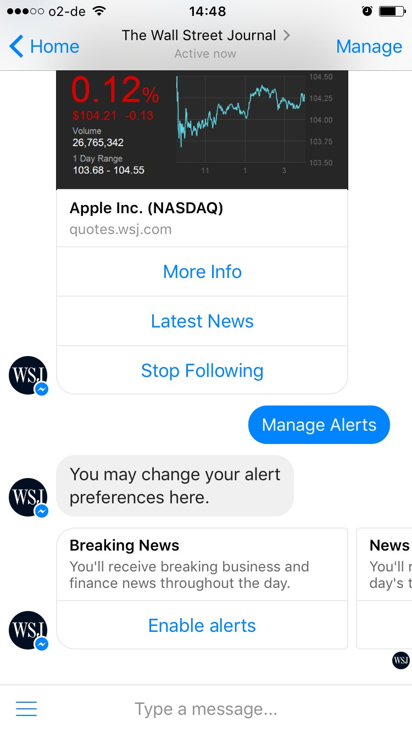
Chatbot Studies

Slide 66
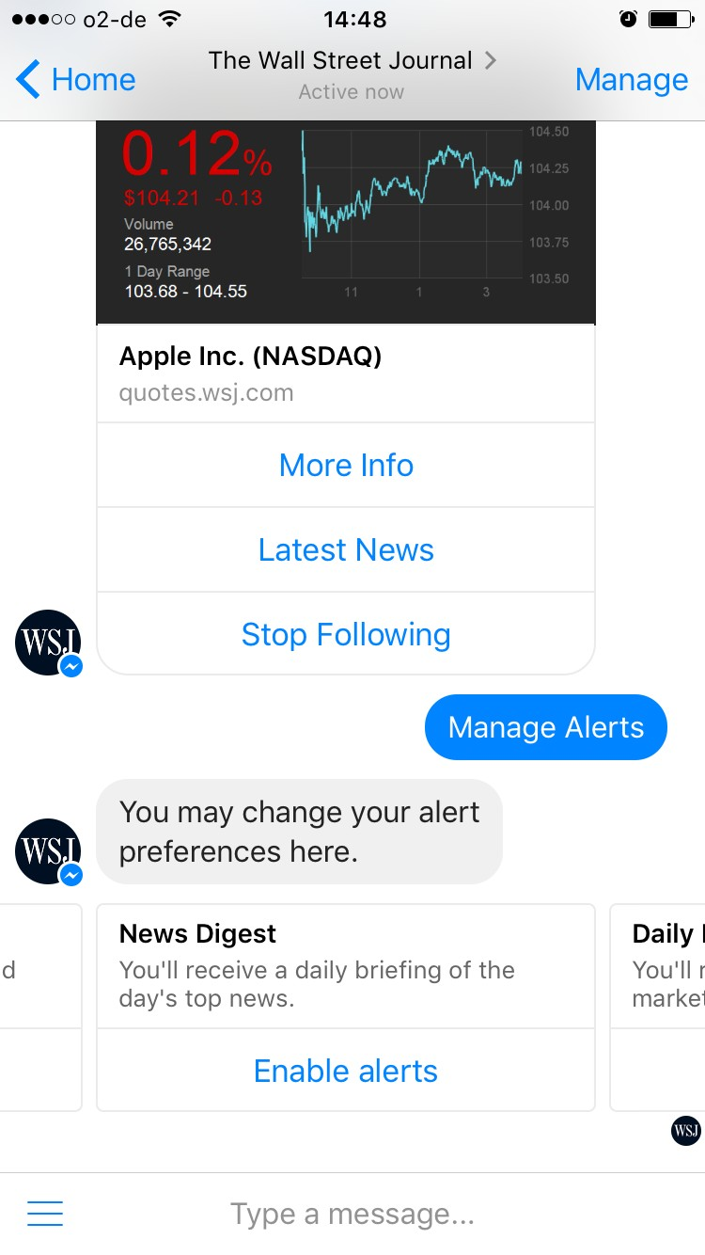
Chatbot Studies

Slide 67
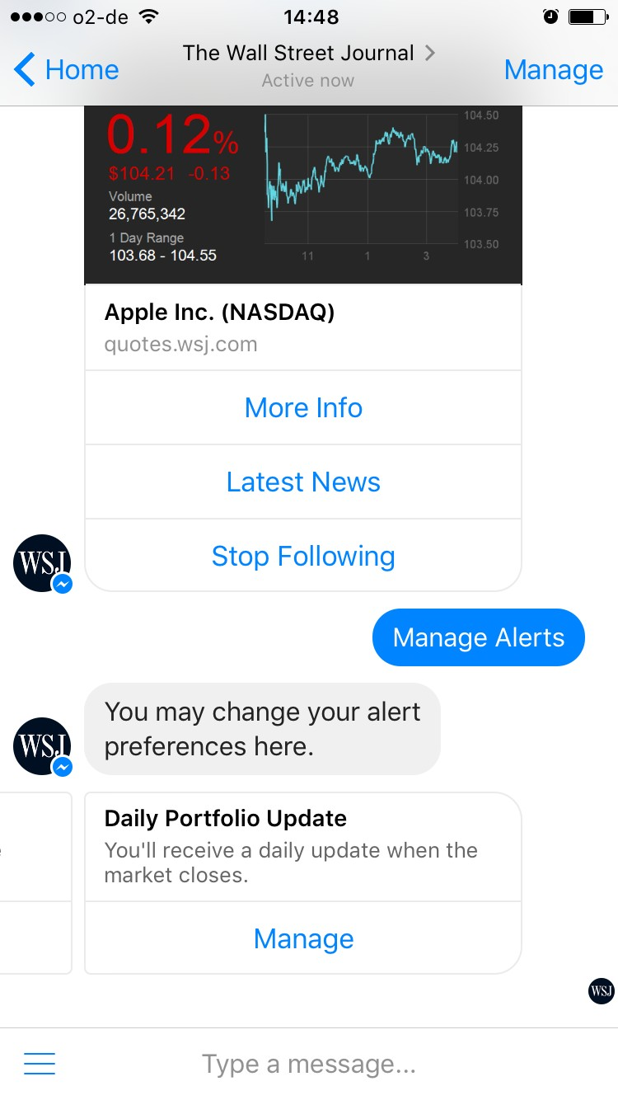
Chatbot Studies

Slide 68
Chatbot Studies

Slide 69
Chatbot Studies
And here’s this help thingy that made me confused before

Slide 70
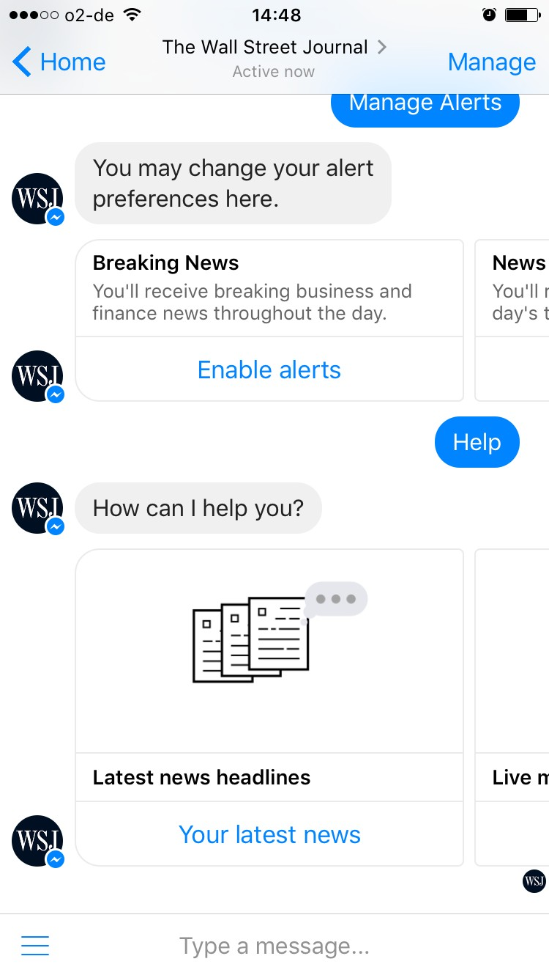
Seems to be the menu
Chatbot Studies

Slide 71
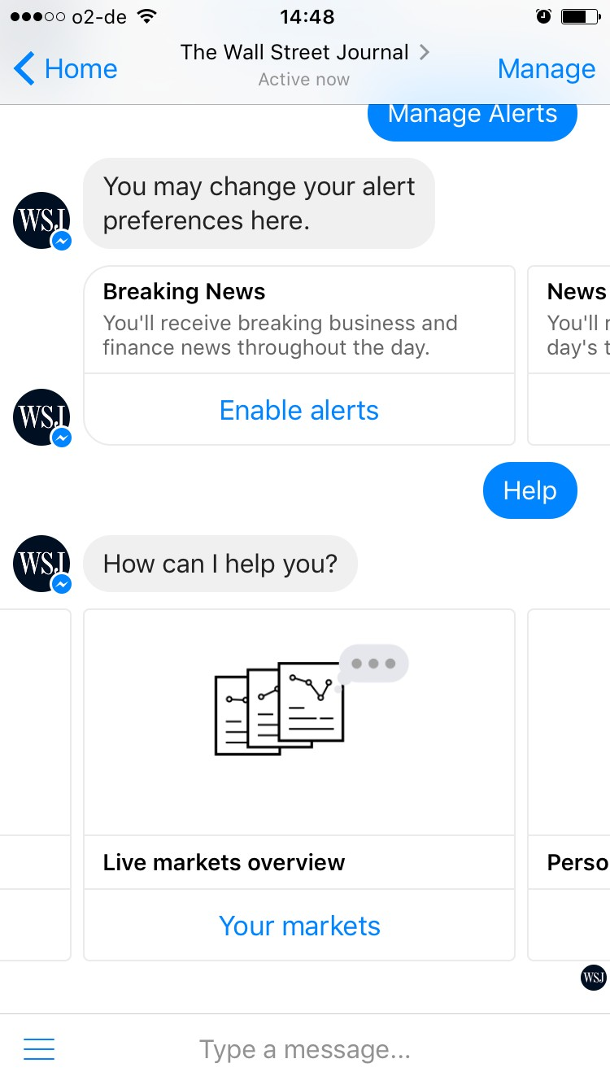
Chatbot Studies

Slide 72
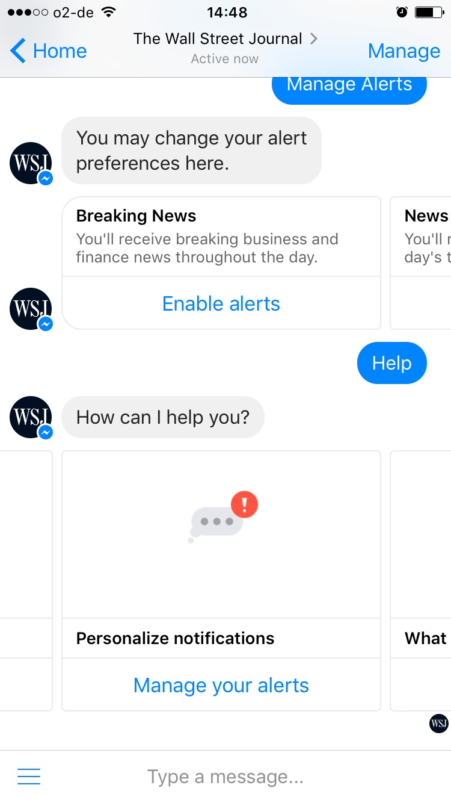
Chatbot Studies

Slide 73
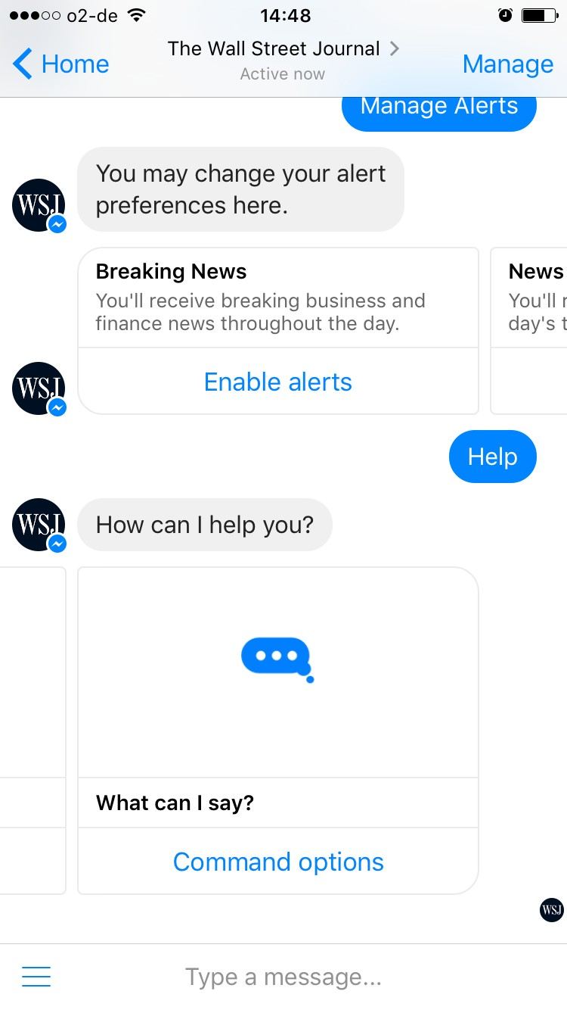
Chatbot Studies

Slide 74
Chatbot Studies
That’s actually what I thought “help” would mean

Slide 75
Chatbot Studies
What can you say, WSJ?

Slide 76
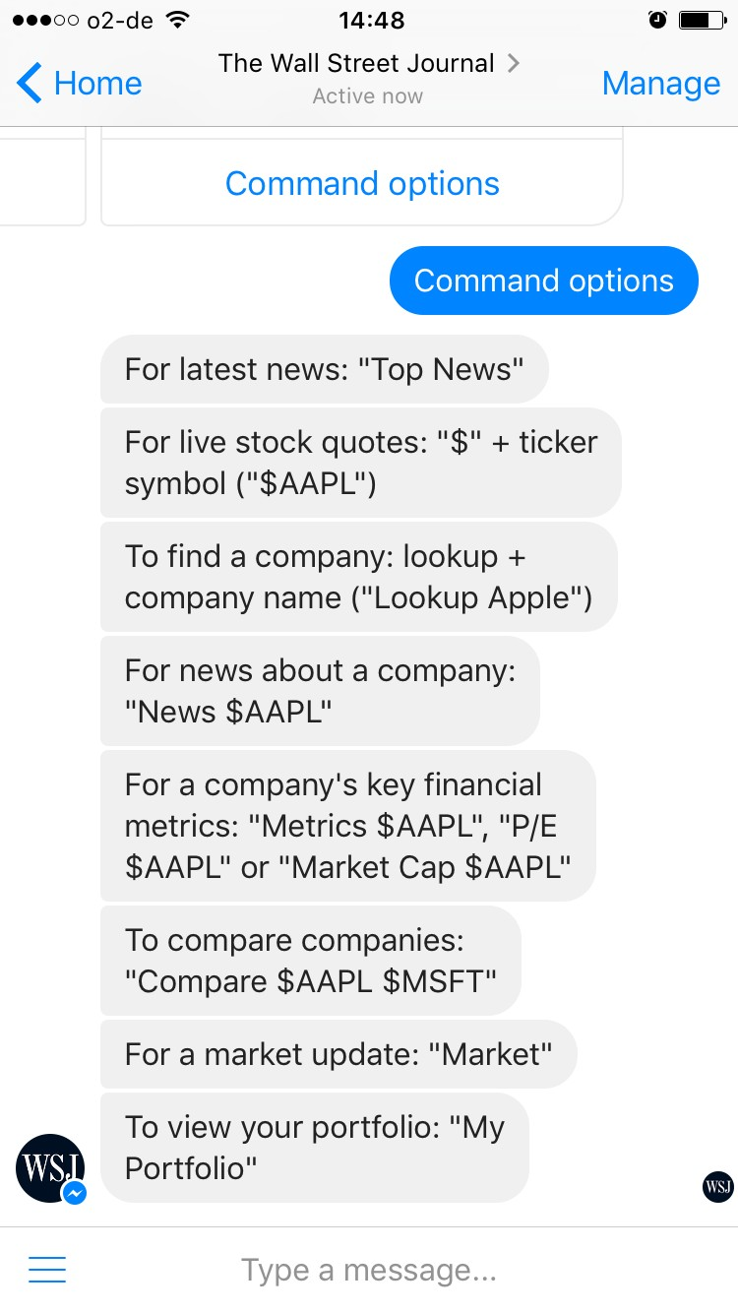

😩
so much text
Chatbot Studies

Slide 77
Chatbot Studies
btw, do emojis and other things work?

Slide 78
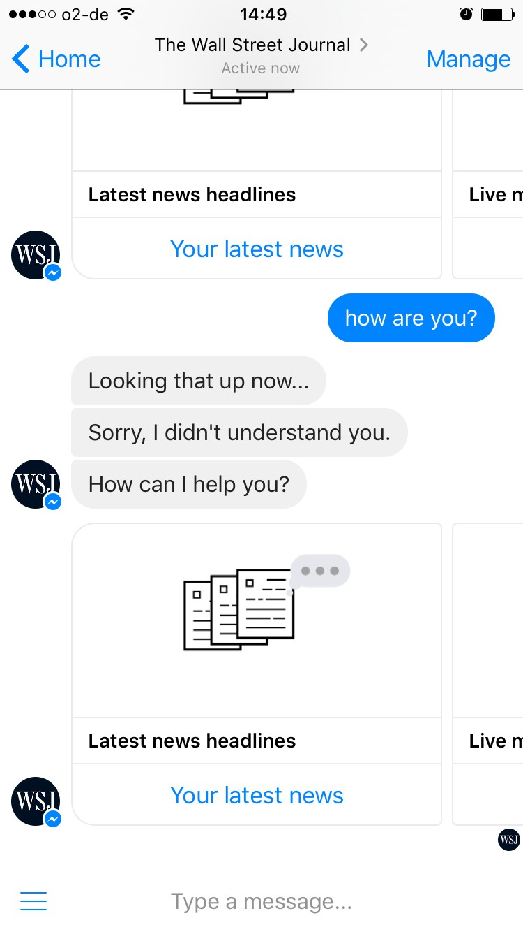
Chatbot Studies

Slide 79
nope
Chatbot Studies

Slide 80
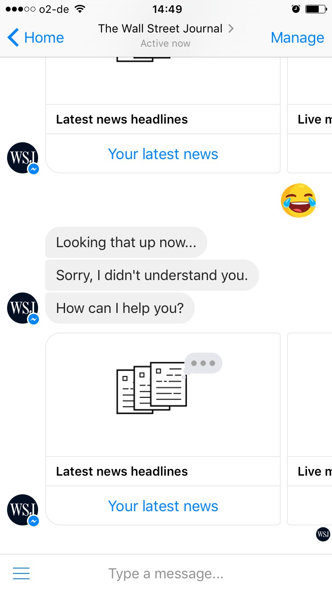
nope
Chatbot Studies

Slide 81

Chatbot Studies
Thanks!
Hope you liked it

Slide 82


Wanna stay up to date?
Chatbot Studies
Message Us!
or go to www.chatbot-academy.com

